Slide 1

Extract Trends from social media data
Coder123
Chandigarh University

Slide 2



MEET OUR TEAM
PURU bHARGAVA
Shivkesh PANDEY
Shikhar GUPTA
Team-Leader
Team Member-1
Team Member-2

Slide 3
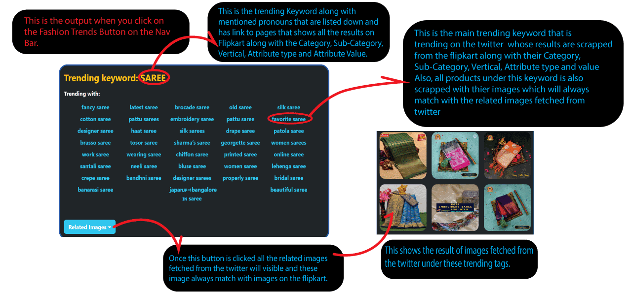
P0: Finding the Trending Keywords

Slide 4
P1: Ranking/scoring logic for trends extracted
All these trending keywords are sorted on the Bases of an algorithm designed by our team which is as follows:
Retweets are given the highest Star Point which is 10 per Retweet.
Likes are given Second Highest Star-Point which is 9 per Like.
Now total Star-Point is reduced based on how old a particular tweet is. 0.1% decrease for a 1-day-old Tweet.
Also, if the tweet contains a media, there is a rise in Star-Point of 10000.
Moreover, if the tweet is explicit then there is a decrease in the Star-Point of 10000.

Slide 5
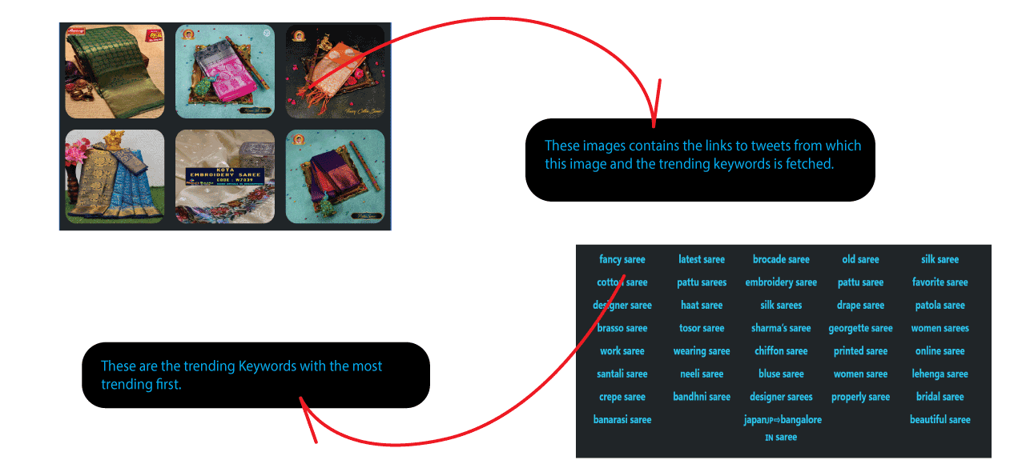
P2: List of trending keywords with sample images and links from which the trend is derived with most trending first:

Slide 6
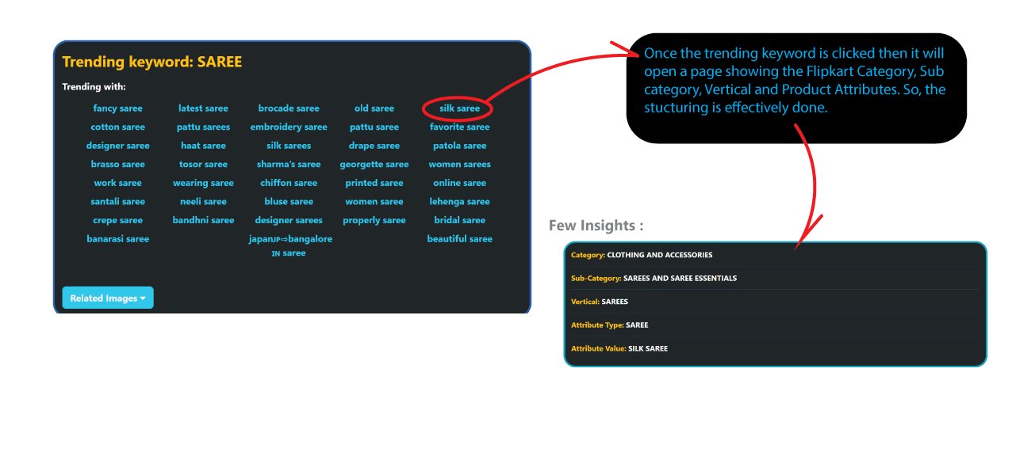
P3: Structured Data According to Flipkart Category, Sub category, Vertical and Product Attributes

Slide 7
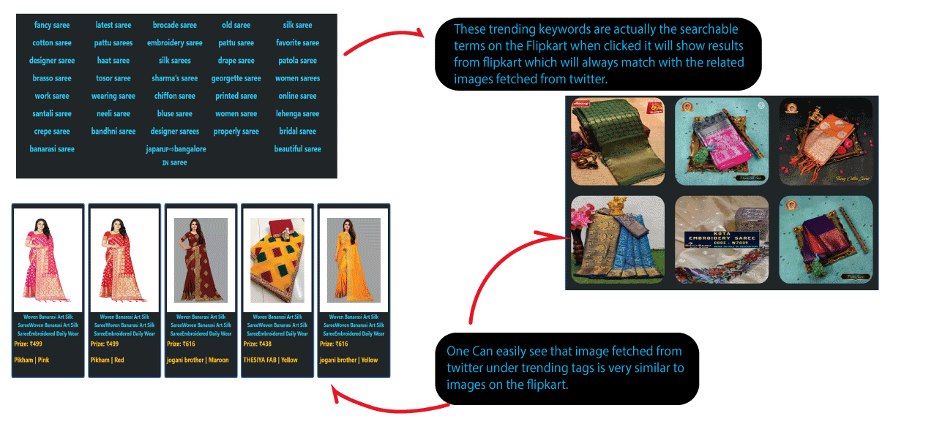
P4: FROM A TRENDING KEYWORD, CREATING A CORRESPONDING SEARCHABLE TERM ON FLIPKART WHICH WILL LEAD TO MATCHING PRODUCTS.

Slide 8
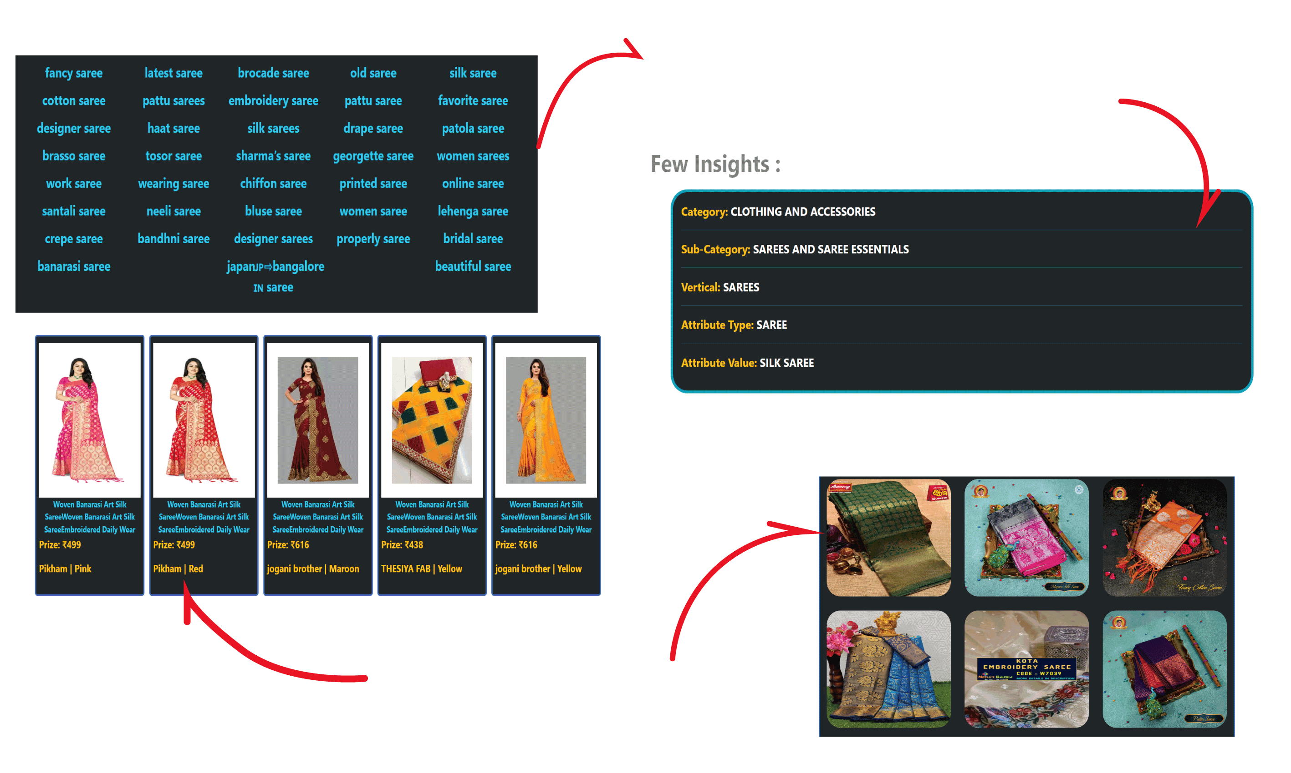
P5: Mapping of Extracted Trending Keywords with Flipkart
If any of these trending keyword is clicked it will open a page displaying all the results scrapped from the Flipkart with their Category, Sub-Category, Veridical, Attribute Type and Value. Also similar products are fetched.
One Can easily see that image fetched from twitter under trending tags is very similar to images on the Flipkart.

Slide 9
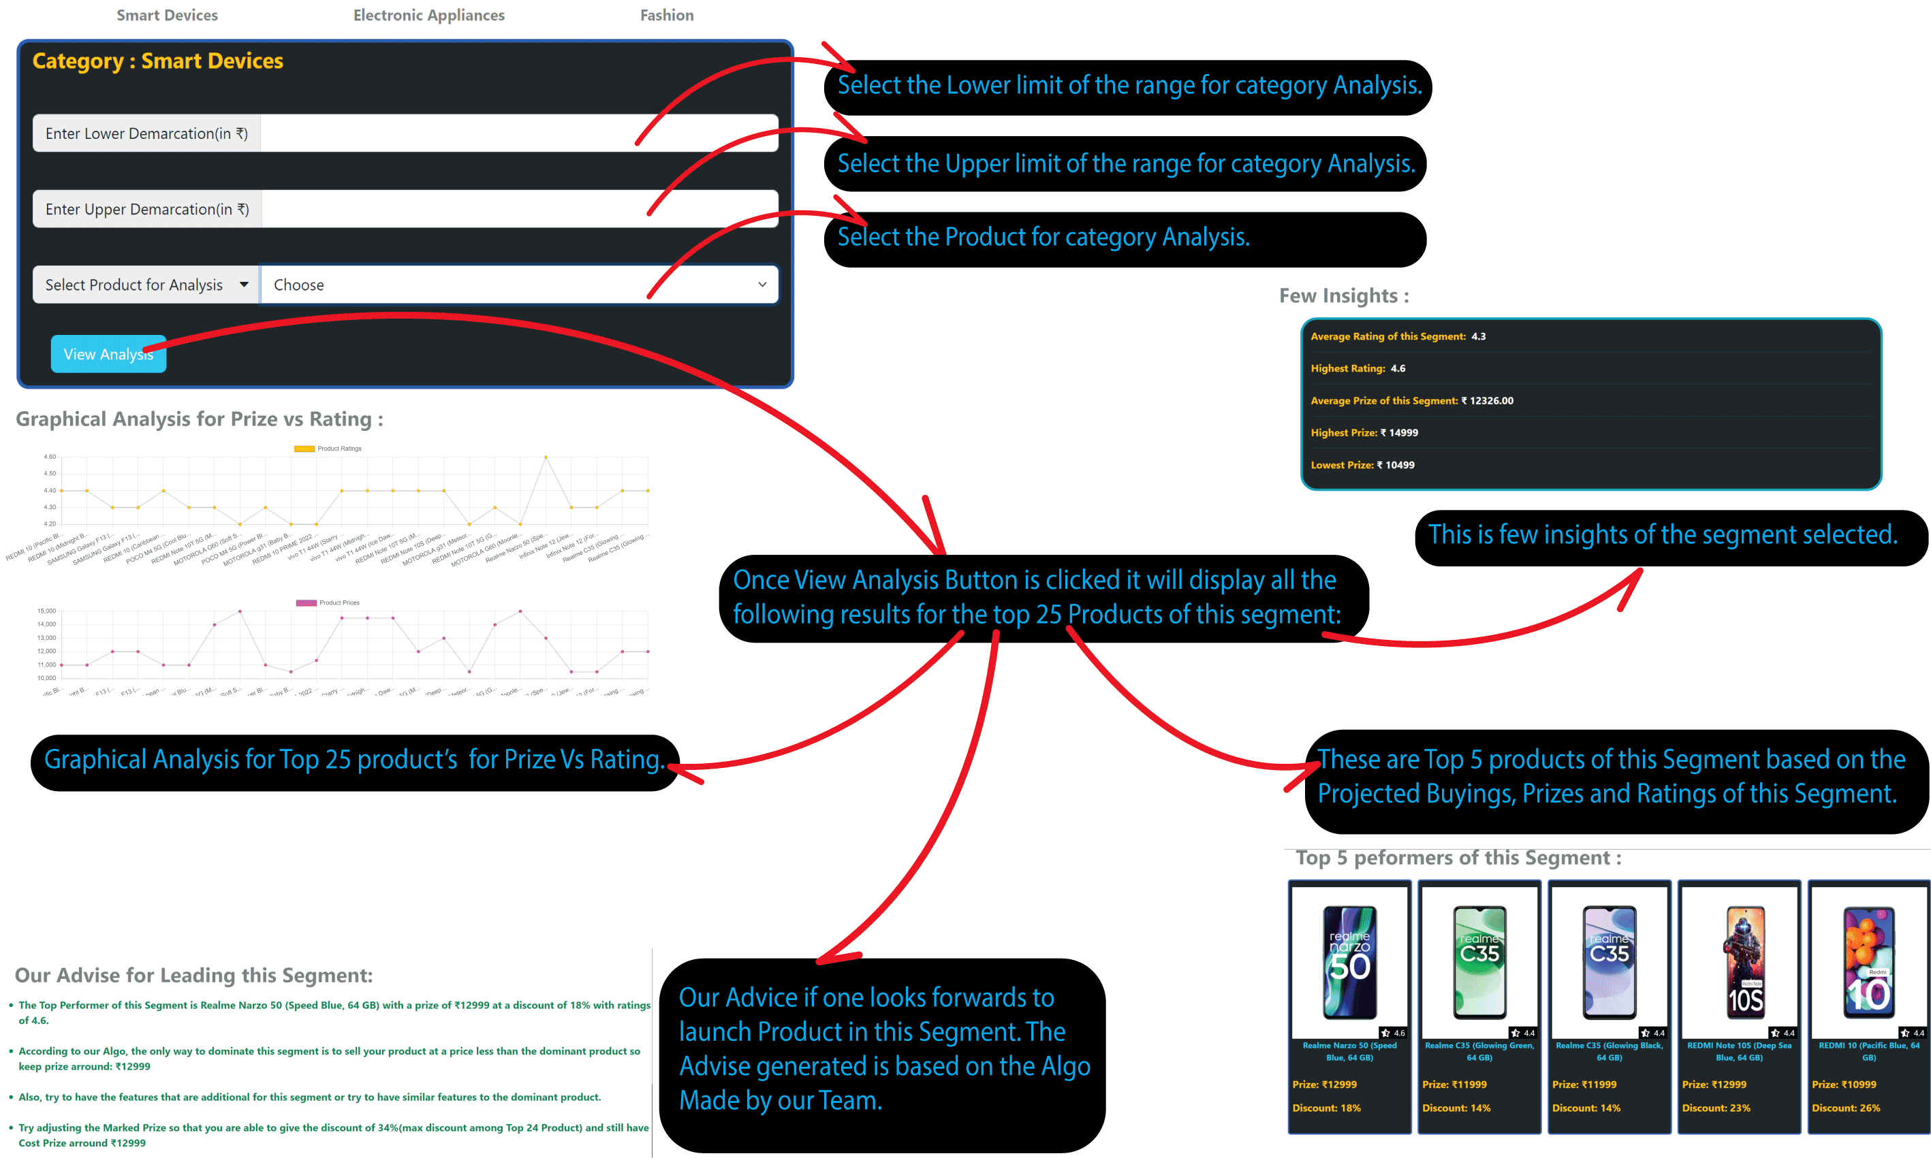
P6: Extra Feauture-3 Category Analysis

Slide 10
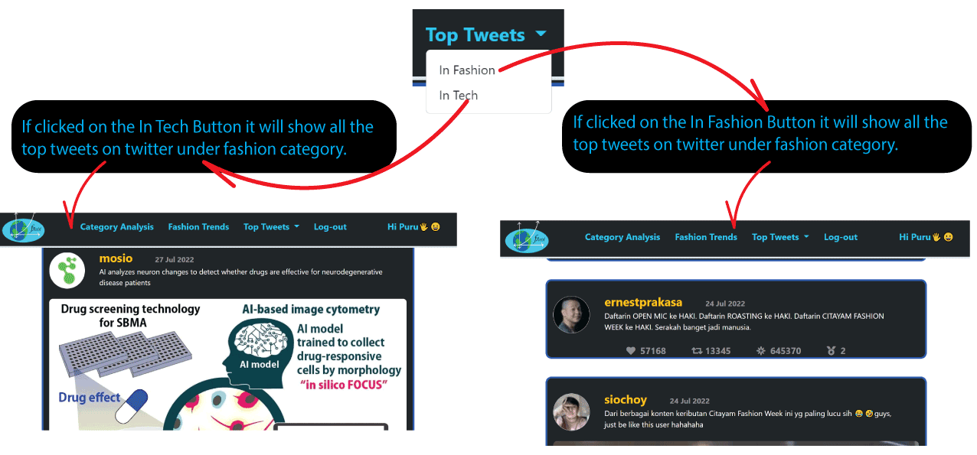
P7: EXTRA FEAUTURE-1, TOP TWEETS UNDER FASHION AND TECH:
P8: EXTRA FEAUTURE-2 RANKING/SCORING LOGIC FOR TWEETS EXTRACTED:
All the tweets under a Category are sorted on the bases of an algorithm designed by our team which is as follows:
Retweets are given the highest Star-Point which is 10 per Retweet.
Likes are given Second Highest Star-Point which is 9 per Like.
3. Now total Star-Point is reduced based on how old a particular tweet is. 0.1% decrease for 1-day-old Tweet.
Also, if the tweet contains a media, there is a rise in Star-Point of 10000.
Moreover, if the tweet is explicit then there is decrease in the Star-Point of 10000.

Slide 11
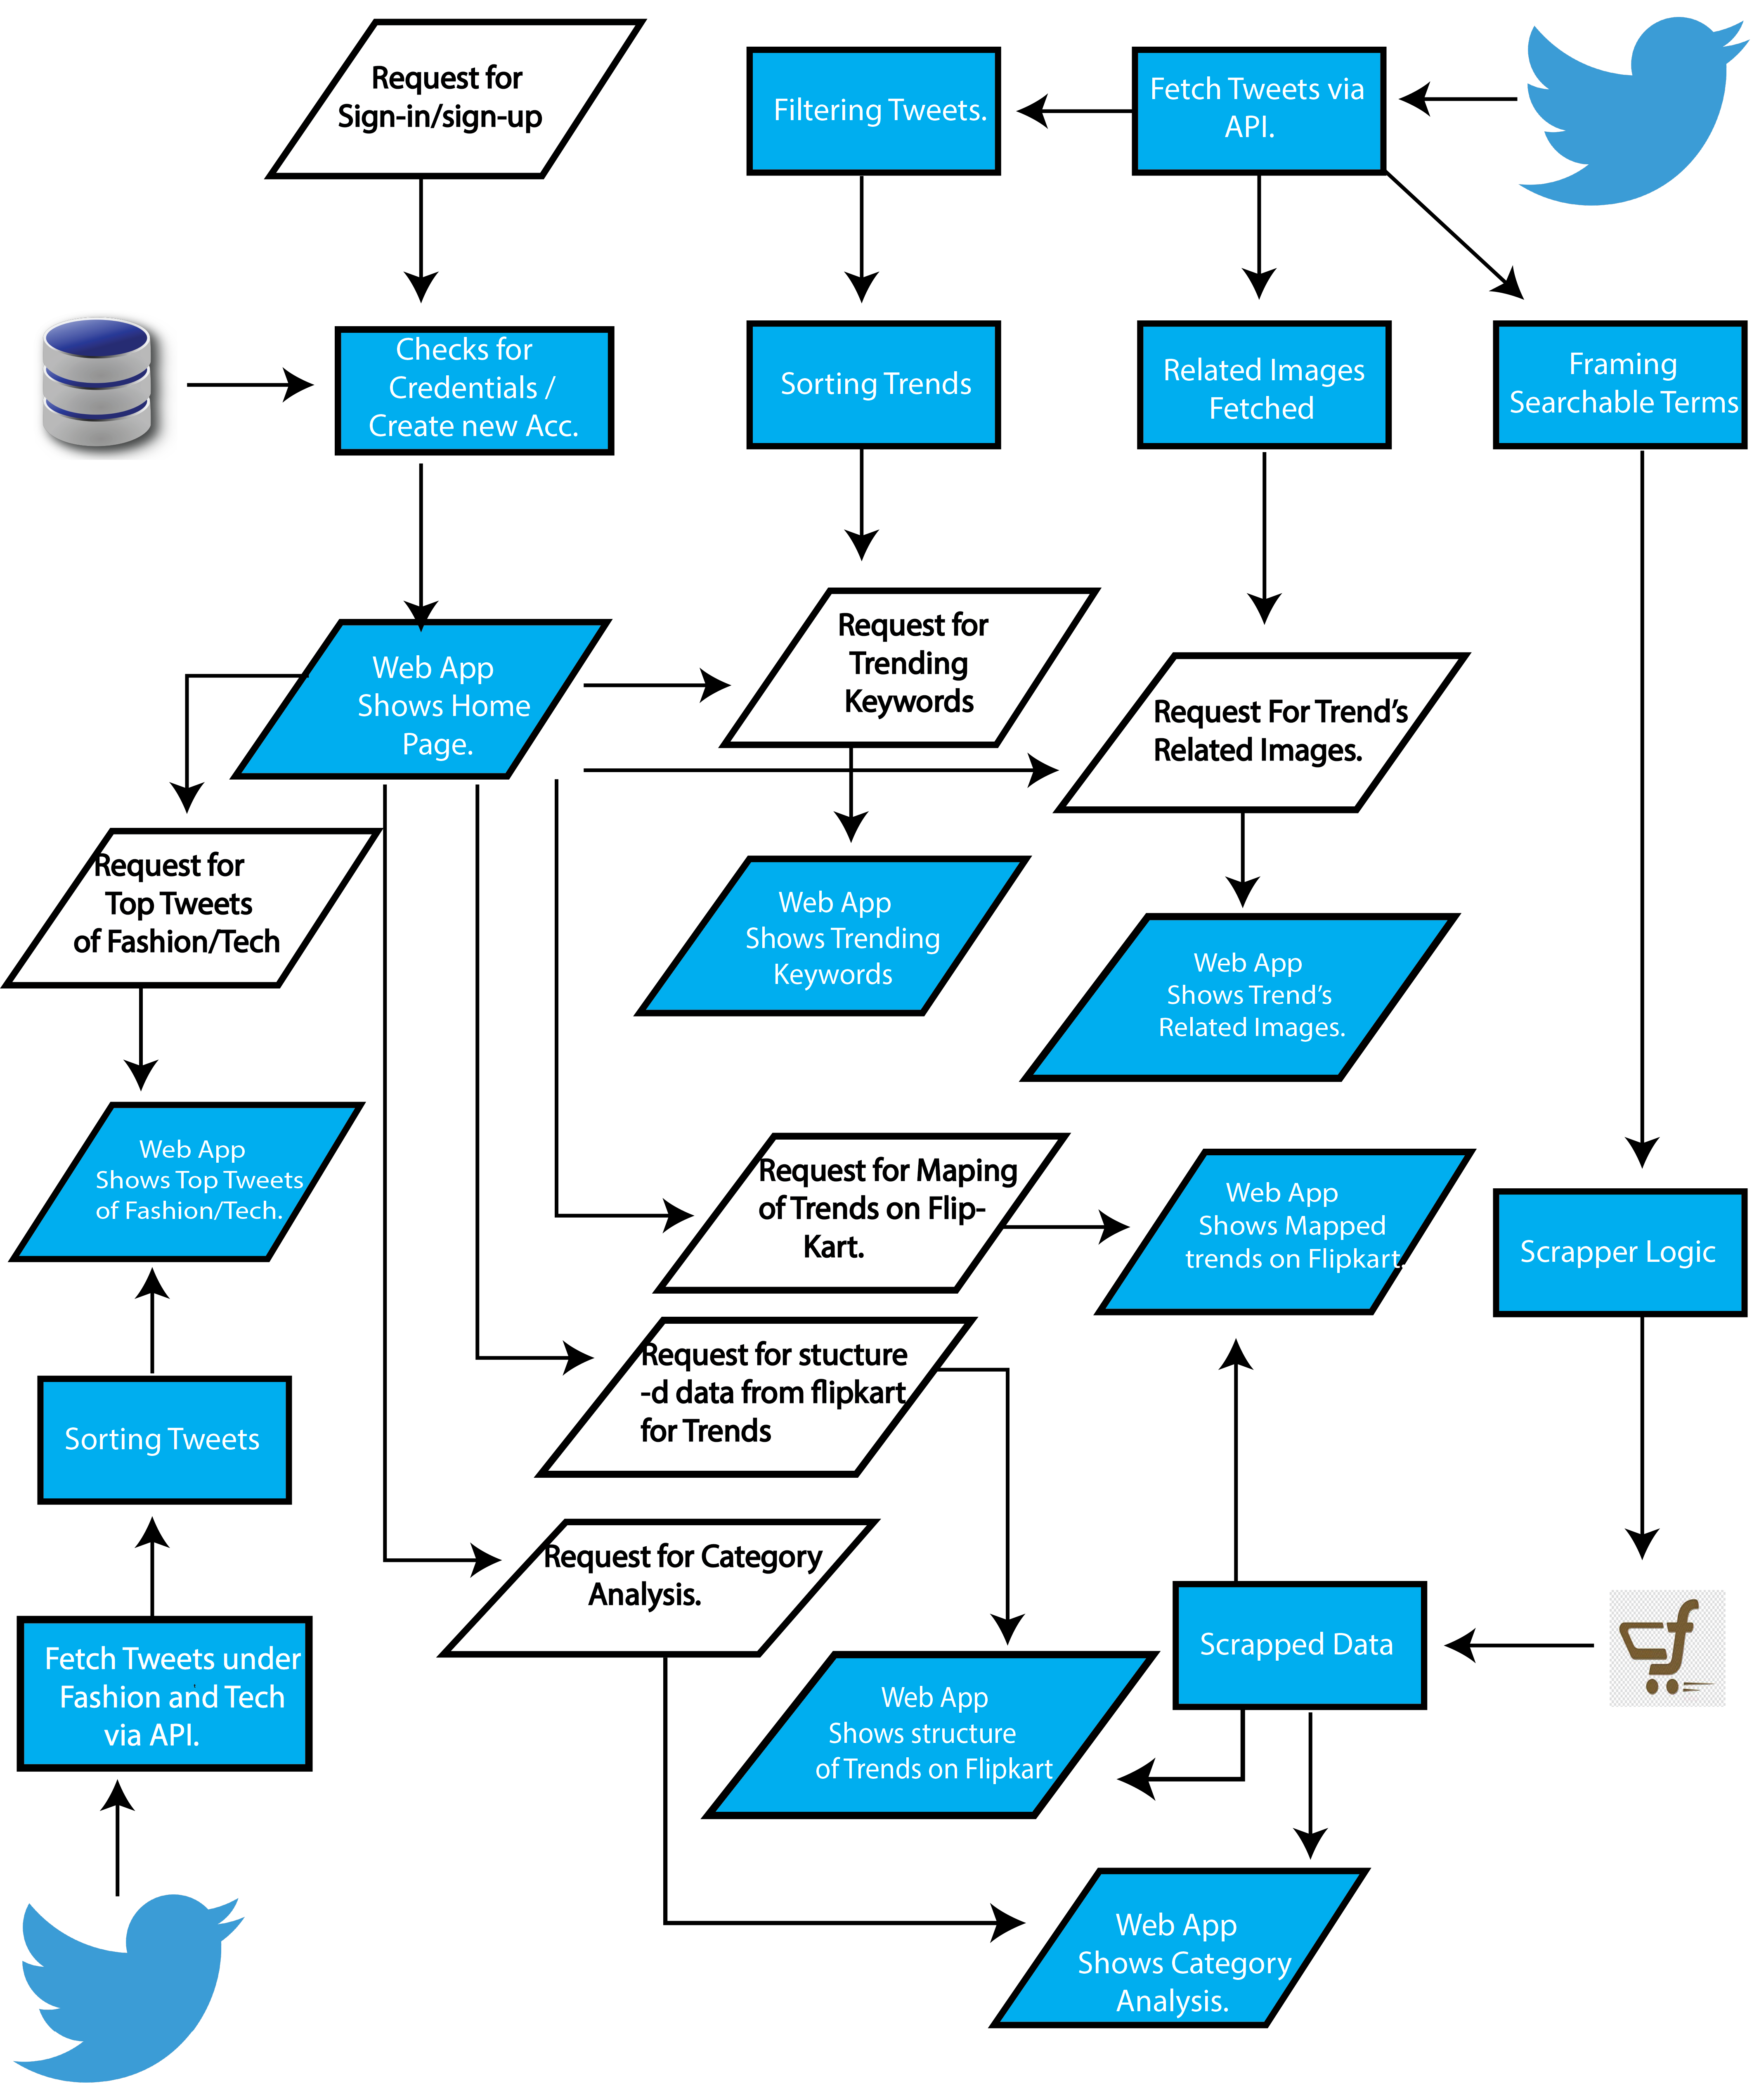
BLOCK DIAGRAM OF
OUR PROJECT.

Slide 12
Advantages of Our Solution
A0: Avoiding Saturation of Stock
Scenario-1 without our Solution
Scenario-2 with our Solution
BBD Sales Starts…
Announcement of
BBD Sales Date
Our Project extracts
Trends
High Customer Demand
Prior Prediction of
Shortage
Saturation of Stocks.
Using Prediction we fulfil our Inventory

Slide 13
Limitations Of our project
L0: Trendsetter:
Some Flipkart sellers with help of some internal assistance might try to bring their Trends into consideration of our Algorithm so that they can clear out their stocks which might result in high-maintenance cost of inventory.
L1: Meme Culture:
Nowadays due to the Meme-Culture, memes are definitely supposed to get trending hence our project will fetch those keywords which are definitely not of our interest.

Slide 14

Future-Scope
Emojis are the problem that needs to be tackled in the future.
Currently our project doesn't support multiple languages.
We need to train our Exclusion algo with the help of few people so that our Algo predict keywords with more accuracy.
New Flipkart-seller can use our Category-Analysis Feature to compete in particular segment.
With the help of geographical Location we tell the new sellers that this category is popular in this area. So he/she can start business in this domain.
Exclusion Algorithm knows what to avoid
Group of 4-5 People
Analysis of tweets
Provide Set of keywords to avoid
Algorithm gets matured
Getting best trends
1-2 Months (max)
System finds out what is the famous business of that region
Find all the trending keyword of that famous business
Credential Login
System obtains geographical location
Ex: Moradabad for Brass

Slide 15
THANK YOU

